Slide 1
SQL Injection Detection Using Suricata IDS

Slide 2
Introduction
Web applications are common targets of cyberattacks
SQL Injection (SQLi) is a critical web vulnerability
IDS tools help monitor and detect malicious traffic
Suricata is an open-source, network-based IDS

Slide 3
Problem Statement / Objective
Web applications often lack proper input validation
SQL Injection can lead to data leakage and system compromise
Need to detect SQL Injection at network level
Objective:
Detect SQL Injection attacks using Suricata IDS
Monitor attack traffic generated from Kali Linux
Analyze alerts generated by Suricata

Slide 4
Tools & Environment Setup
VMware Workstation – Virtualization platform
Kali Linux – Attacker machine
Metasploitable 2 (DVWA) – Vulnerable web server
Ubuntu Linux – Suricata IDS

Slide 5
Network Configuration
All VMs on same NAT network (VMnet8)
Required for packet visibility
IP Addresses:
Kali Linux: 192.168.160….
Ubuntu (Suricata): 192.168.160…
Metasploitable 2: 192.168.160…

Slide 6
Suricata Configuration File
Sudo nano /etc/suricata/suricata.yaml
The suricata.yaml file is the main configuration file. It defines network variables, rule paths, logging formats, and detection behavior. Any misconfiguration here can prevent Suricata from working correctly.

Slide 7
HOME_NET Configuration
HOME_NET: "[192.168.160.130]"
HOME_NET defines the network assets that Suricata is protecting. By setting it to the Metasploitable 2 IP, Suricata focuses on traffic destined for or coming from the vulnerable server, improving detection accuracy and reducing false positives

Slide 8
Local Rules Concept
Custom detection rules
Used for specific attack patterns
Stored in local rule files
Suricata supports custom rules that allow security analysts to detect specific attacks. These rules search for suspicious patterns such as SQL keywords, operators, and symbols commonly used in SQL Injection attacks.

Slide 9
Testing Configuration
sudo suricata -T -c /etc/suricata/suricata.yaml
This command validates the Suricata configuration and rules before deployment. It ensures that all files are correctly loaded and prevents runtime errors during traffic analysis.

Slide 10
SQL Injection Detection Rules
Detect single quotes (')
Detect OR conditions (OR 1=1)
Detect UNION SELECT statements
SQL Injection attacks often include recognizable patterns. Suricata rules look for these patterns in HTTP requests. When a match is found, an alert is generated, indicating a possible attack.

Slide 11
Accessing DVWA
Open browser in Kali Linux
Navigate to Metasploitable IP
Open DVWA
DVWA is intentionally vulnerable and provides a safe environment to test SQL Injection attacks. Setting the security level to low disables input validation, allowing attacks to succeed.

Slide 12
SQL Injection – Error Based Test
1’
This payload breaks the SQL query syntax and causes a database error. It confirms that the input is not properly sanitized and that the application is vulnerable to SQL Injection.

Slide 13
Authentication Bypass Attack
1' OR '1'='1
This condition is always true, forcing the database to return all records. Attackers commonly use this technique to bypass login mechanisms

Slide 14
UNION SELECT Attack
1' UNION SELECT 1, @@version#
UNION SELECT allows attackers to extract additional data from the database. The @@version variable reveals the database version, which helps attackers tailor further attacks.

Slide 15
Data Extraction Attack
-1' UNION SELECT user, password FROM users#
This advanced SQL Injection payload extracts sensitive data such as usernames and passwords. It represents a real-world data breach scenario.

Slide 16
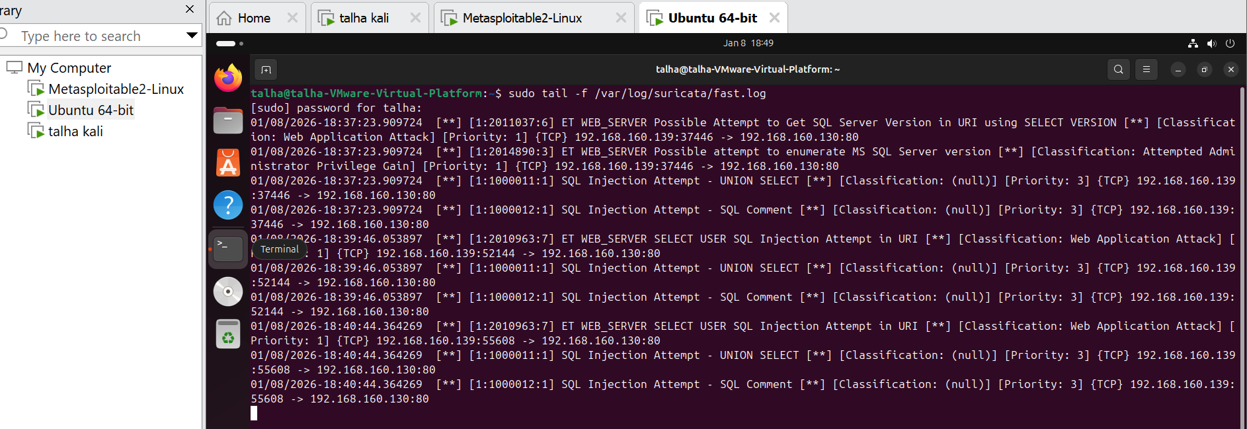
Suricata Logs
sudo tail -f /var/log/suricata/fast.log

Slide 17
Thank you

